Slide 1
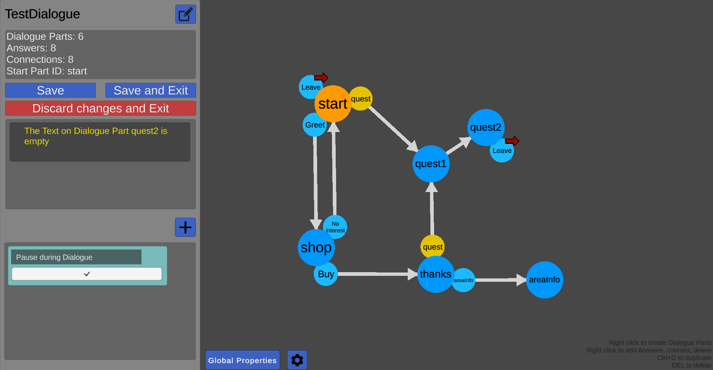
Easily create complex, branching dialogues for your game

Slide 2
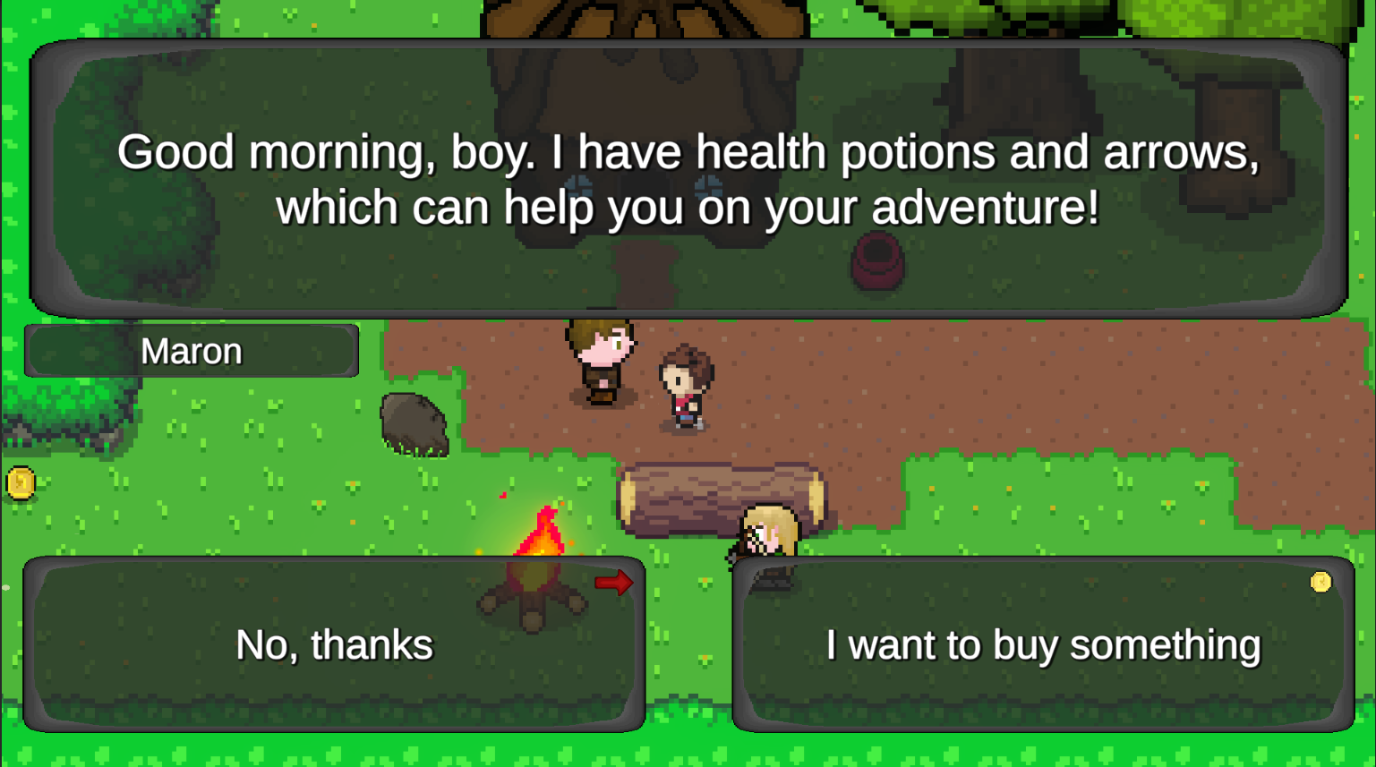
Powerful, yet easy to integrate with your UI and systems in a wide variety of games and genres

Slide 3
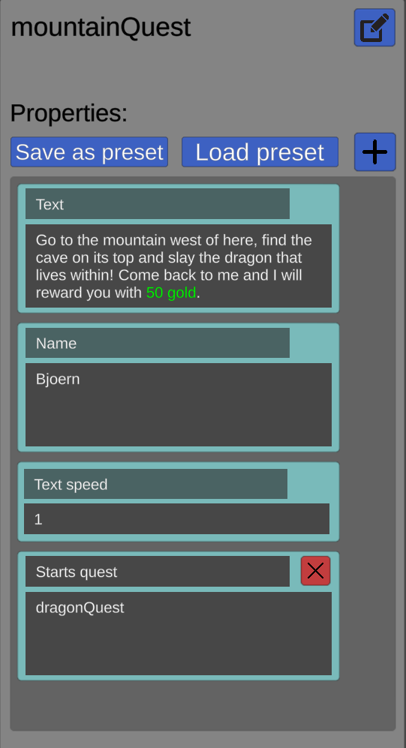
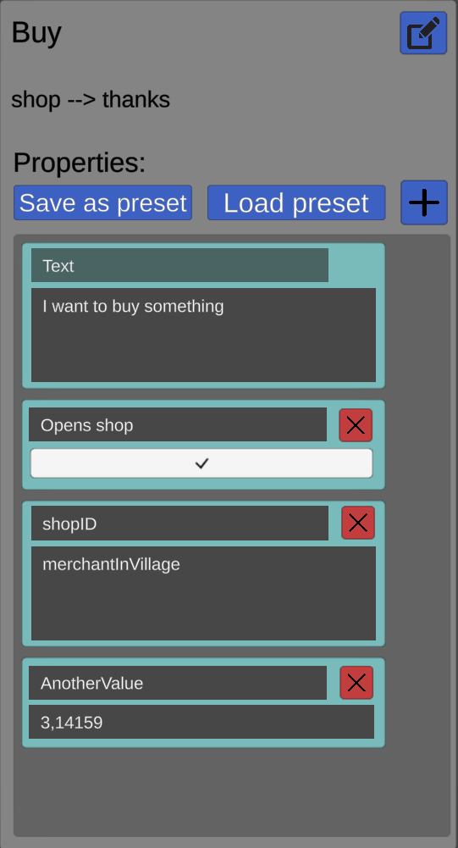
Add custom data to all parts of your dialogues and access them from code

Slide 4
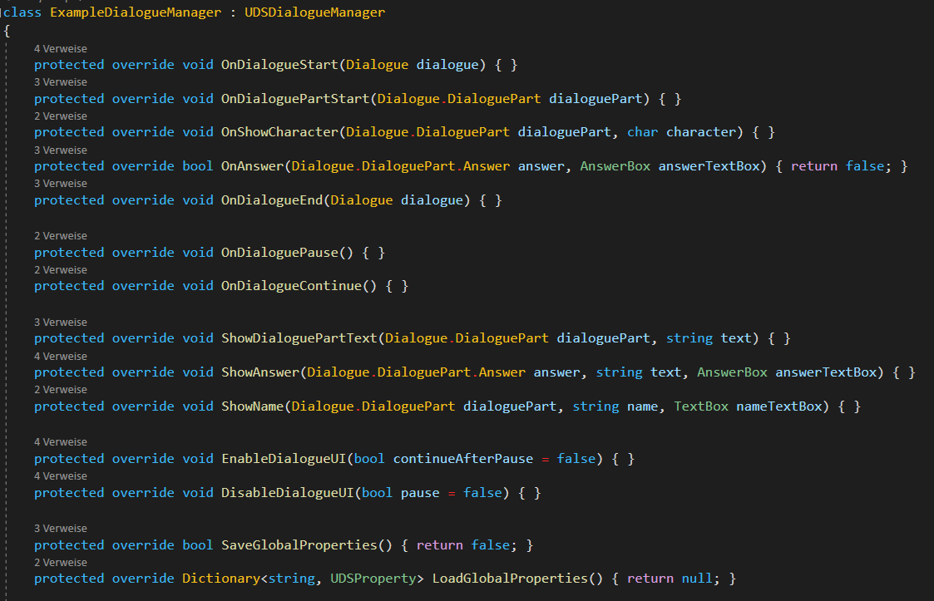
Add loads of custom functionality in a way similar to how Unity‘s MonoBehaviours work

Slide 5
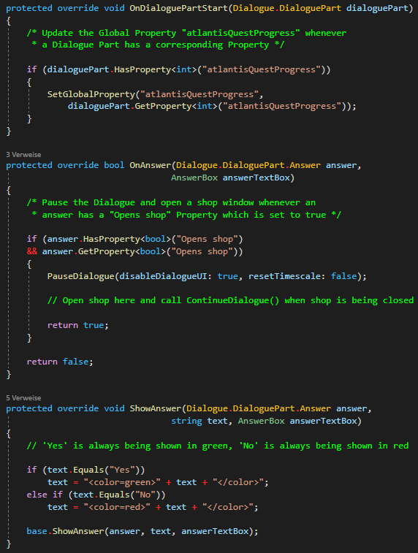
Add loads of custom functionality in a way similar to how Unity‘s MonoBehaviours work

Slide 6
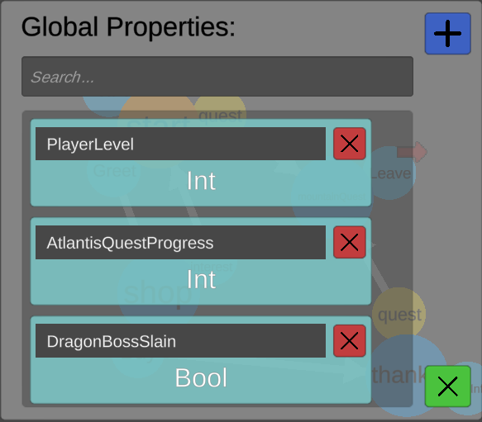
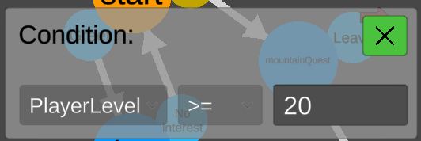
Change the course of your dialogues based on the state of your game

Slide 7
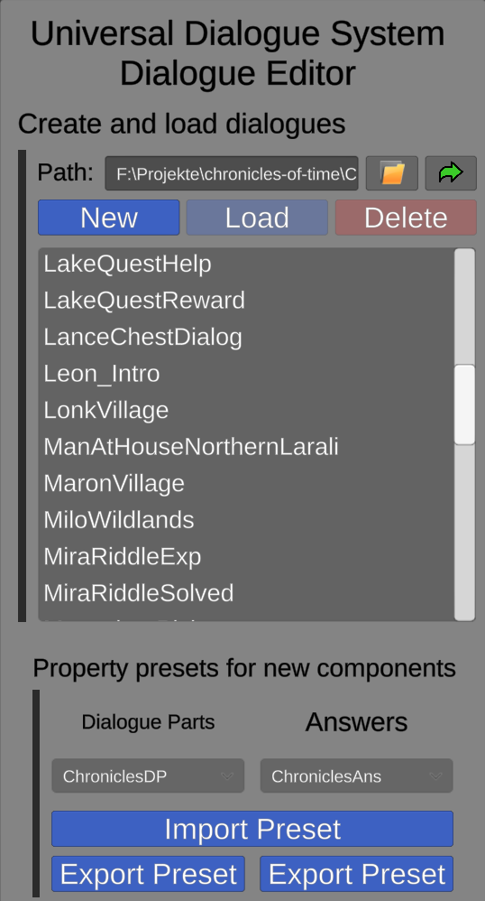
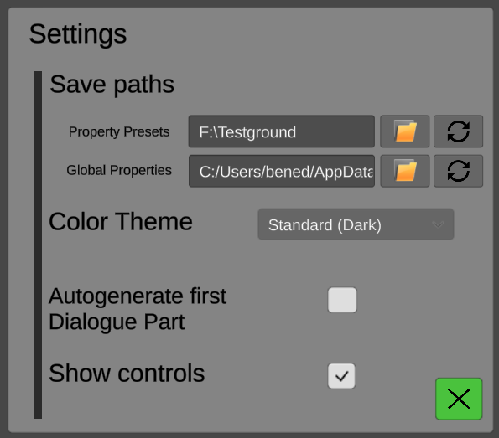
Take advantage of a variety of convenience features for working on bigger projects and in teams

Slide 8
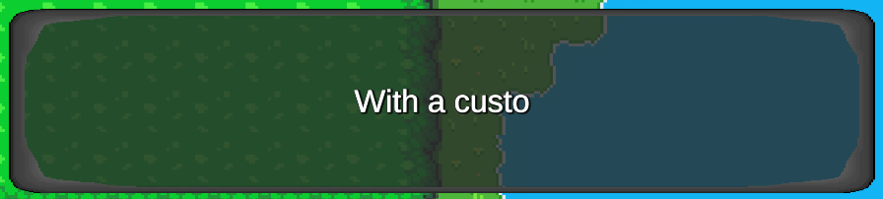


With TextMeshPro support and a customizable text reveal/scrolling text animation

Slide 9

A custom-made parser algorithm allows for full Rich Text support including inline images

